Slide 1


From
Global 1: Pest International to
Global 2: Corvid 19 International
Ise-Mikawa River-Basin Bio-Region Model
All-Inclusive Reconciliation
Between Nature & Culture, West & Rest
Kinhide Mushakoji (RCE Chubu)

Slide 2

From the 14 Century Pest to the Corvid 19
The Pest Killing one third of European Population
Prepared European Capital-Intensive Modern Economy.
The Corvid 19 will put an end to Rich/Poor gap Globalization and open a Global Bazaar Economy based on accelerated monetary flow and multi-cultural exchange. The Silk Road will become a Model Region

Slide 3
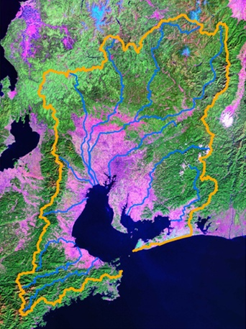
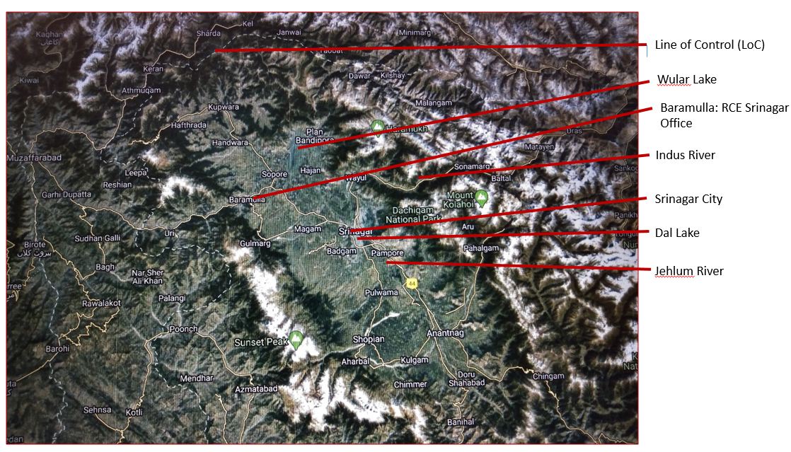
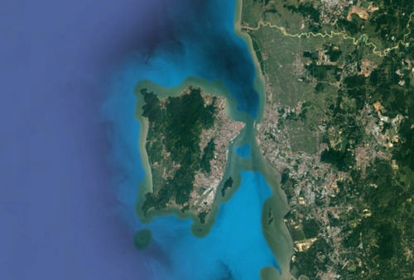
New World Federalism based on SDGs
Bio-Regionalism + Subsidiarity=World Federalism
RED (Radical Ecological Democracy)
2. World Citizen Assembly
Global Bazaar⬄SNS Cleaned from Hate Criminal Inputs
can become a Glocal Bazaar where multi-cultural groups
negotiate on separate issues like they do in the Silk Road
Bazaars. This is the new World Citizen Assembly.
3. Non-Killing States
Surmounting the War on Terror Terrorising the State.
by eliminating the Westphalian States right to kill legally.
RCE Chubu and the bioregion (Ise-Mikawa Bay river basins)
RCE Srinagar and the bioregion (Himalaya hills)
RCE Penang and the bioregion (Penang Island)

