Slide 1
Sustainability Transition: Food

Slide 2
The Paradoxes and Crisis in food and agriculture
Food exporter, undernourished
Food producers, food buyers
Low products price, high food price
Water, food, energy nexus
Middle income trap
Free trade – patent of living organism
Climate crime, conservation vs poverty
Global vs local food, food miles

Slide 3
Small farms vs industrialized farm
Small farmers feed the world with less than 25% of the world's farmland
https://dl.dropboxusercontent.com/u/59856386/small%20farmers/StatPlanet.html

Slide 4
Changing faces of ‘farmer’
Traditional farming household- subsistence
Conventional farming household
Absentee farmer
Workers in their own farm (contract farming)
Corporate/industrialized farm
Farmer entrepreneur
City/urban farmer
restaurant-farmer

Slide 5
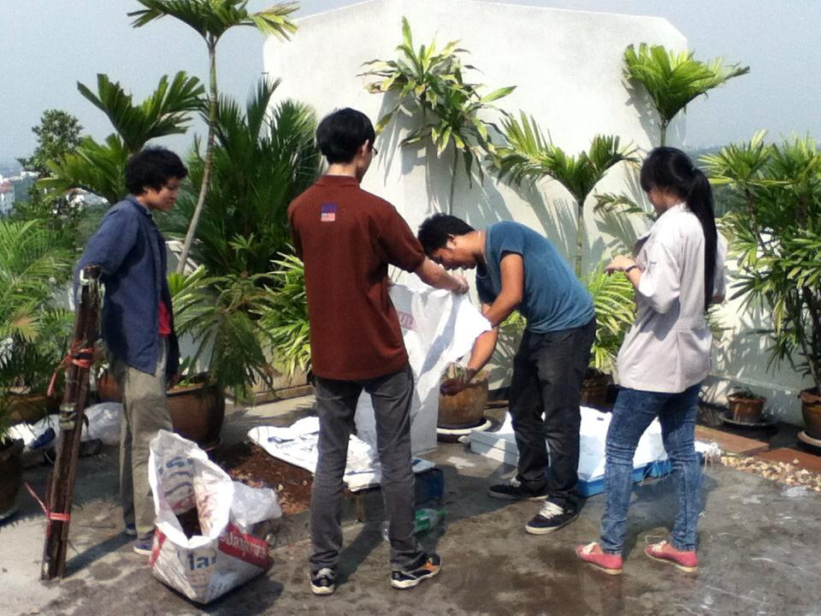
City Farm

Slide 6
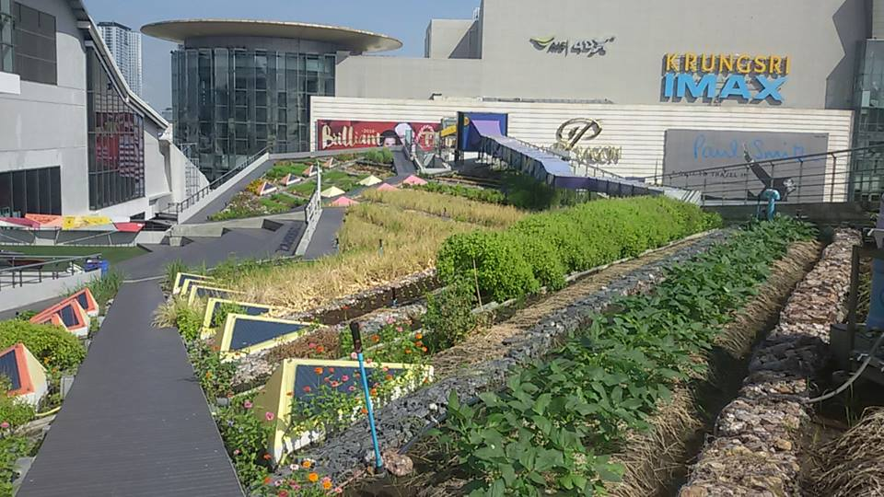
Roof top farm

Slide 7
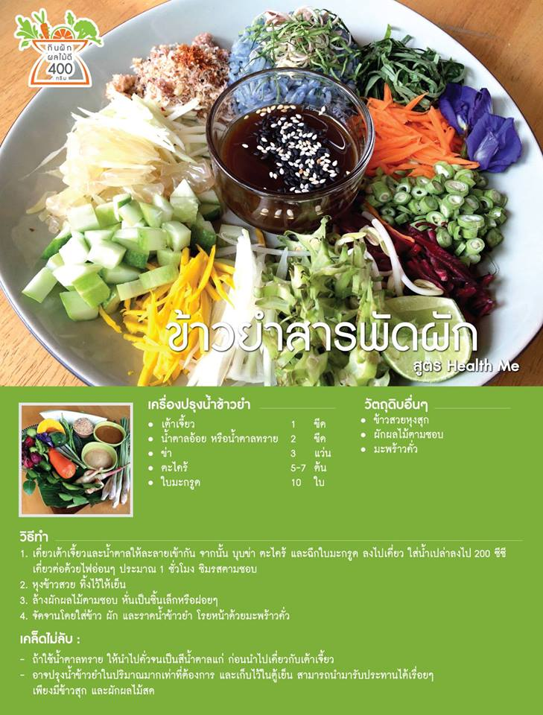
Healthme Delivery

Slide 8
Contract Farming
Contract farming, ideally, can be successful for both investors and farmer. In reality, most farmers in ‪#‎Thailand‬ do not have much negotiation power and lack adequate support.
Pros and cons of contract farming in Thailand (VIDEO)
BANGKOKPOST.COM|BY POST PUBLISHING PCL.

Slide 9
Yong Farmers
https://www.facebook.com/thailandyoungfarmers/photos/pcb.286645625013808/286645121680525/?type=3&theater

Slide 10
The Passage toward Sustainable Agriculture in Thailand
Issues | Before the movement | 1977-86 B.E. 2520 | 1987-96 2530 | 1997-2006 2540 | 2007 + 2550
Dominant thinking | modernization | Self-reliance | Fukuoka Natural agriculture | New theory agriculture/ sufficiency economy Organic Farming Food Safety | Food resources and food security
Emerging technology | Green revolution Mono crop, high yield Gene revolution GMOs (1996) | Integrated farming Agro-forestry | Natural control | Organic farming Integrated farming Traditional variety improvement | Organic Genetic, Standard, Less water variety
Strategy | Transfer of technology Input subsidy | Individual farm model | family farm, organic rice farming group, network of alternative agriculture | Farming household network Alternative market Marketing strategy | Farmer –consumer linkages, Gene bank Farmer’s seed development institute, Toward Organic Asia

Slide 11
Passage toward sustainable agriculture
draft\passage of sust agriculture SSF3.docx

Slide 12
Policy disputes
Free trade and intellectual property rights on living organism
Land acquisition and the common
GMO farms
Water-energy-food nexus: dams and the river, bio-fuel
Farm subsidies

Slide 13
Sustainability transition and small farmers
Diversify options
Consumption culture
Protection of genetic resources
Consumer-farmer

