Slide 1
Seven Developing Countries: From Emergence to Entrapment
Erebus Wong
The Third South-South Forum
Lingnan University, 23rd July, 2016

Slide 2
Development and Post-colonial Condition
National Independence Movements & Industry Transfer
Global Trade & Post-coloniality
International Institutions of Dependence
Bretton Woods System, IMF, World Bank, WTO
Global Structural Dependence
Post-colonial or neo-colonial?

Slide 3
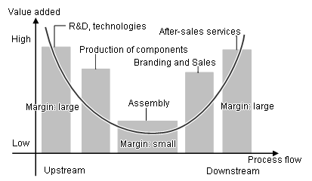
Smiling Curve of Value Added

Slide 4
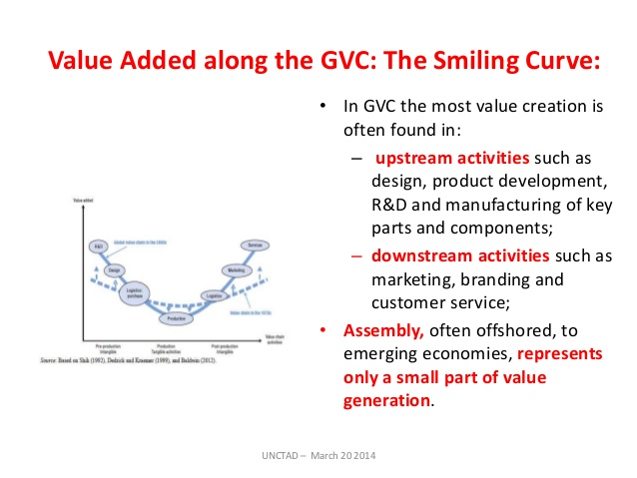

Slide 5
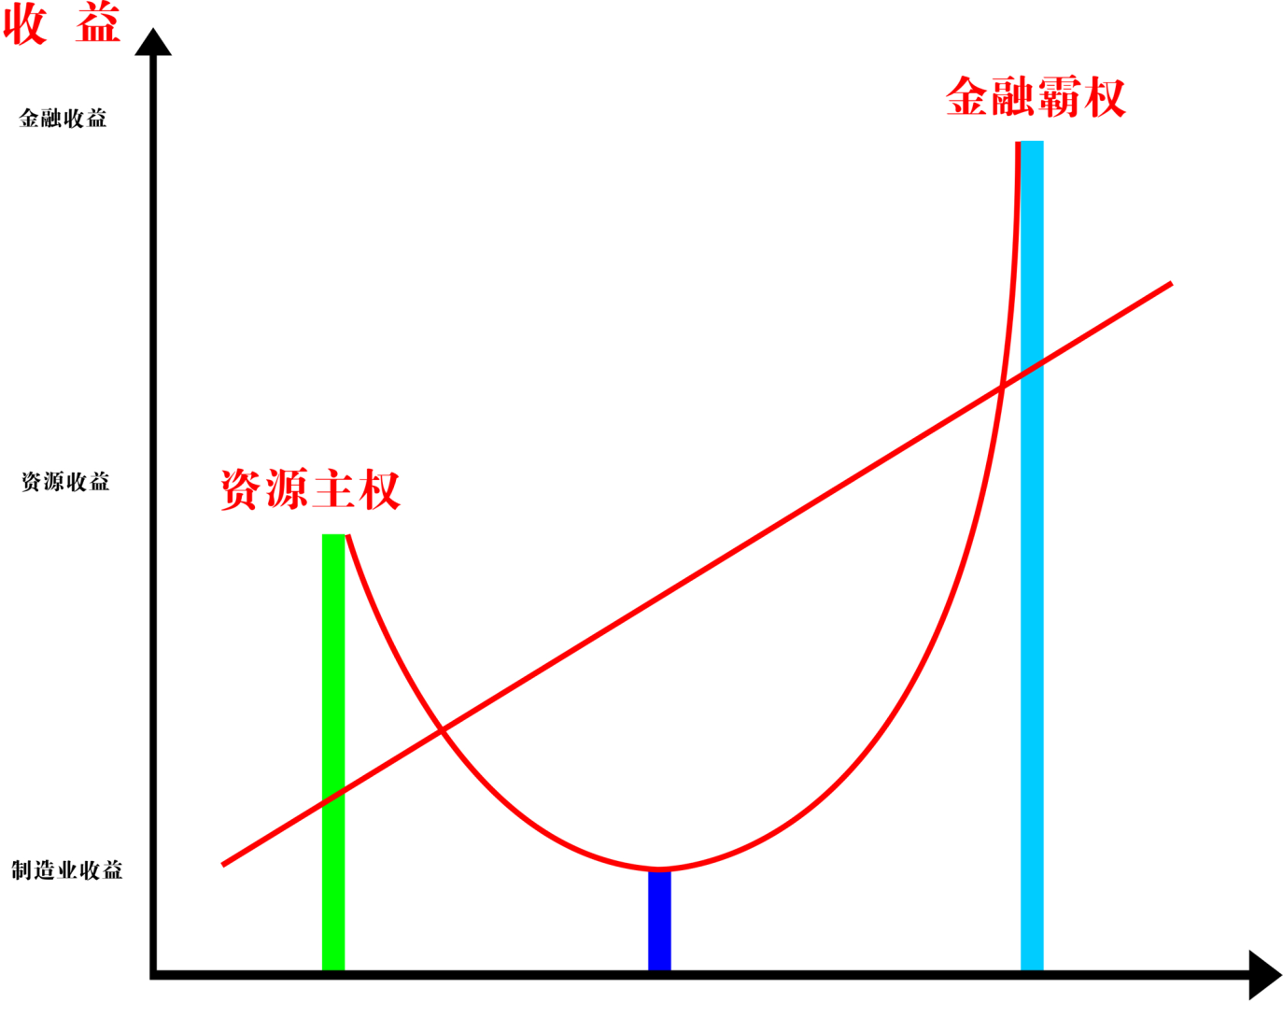
Smiling Curve of International Division
Profitability
Financial/Currency
Hegemony
Finance
Resources
Sovereignty
Resources
Industry
Transfer
Manufacturing
Economic
Structure
Resources
Economy
Manufacturing
Finance

Slide 6
Global Financial Capitalism
1971 The End of Gold-Dollar
1973 Post Bretton Woods
US dollar supply increases astronomically
Deregulation
Neo-liberalism
The Age of Super Financial Capitalism
Liberal/Neo-liberal regimes of wealth concentration

Slide 7
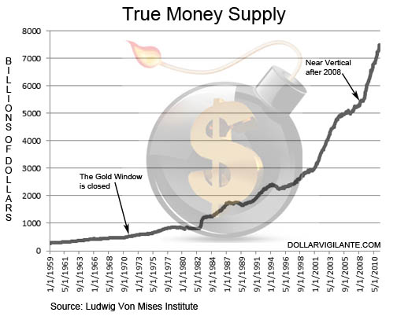
Unconstrained Money Supply

Slide 8
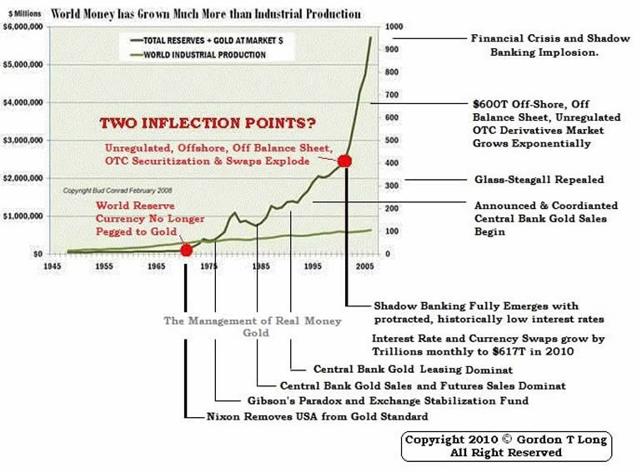

Slide 9
Chronology of Super Financial Capitalism
1944 The Bretton Woods System The Unholy Trinity: IMF, World Bank, WTO
1971 Abolition of Dollar Gold Standard, US dollar liquidity
1974 Oil Crisis
1970s Latin American Debt external debt from $75 billion in 1975 to more than $315 billion in 1983. 50% of the region’s GDP. (Petrodollar)
1979 Interest rate rocketed in US and Europe
1980 US Savings & Loans
1981 Defined-contribution pension plan 401(k) program
1982 Mexico Default. Third World Debt Crisis
1985 Plaza Accord. Japan Assets Bubble
1987 Black Monday
1988 Junk Bonds (The Wolf of Wall Street)
1989 Washington Consensus (Neo-liberalism)
Deregulation (financial liberalization) 1992 US Financial Regulation Institutions employees: 20000 → 2000 14000
1991 Japan Bubble Burst

Slide 10
1990s Japanese Yen Carry Trade
1994 US Bond Crash
1995 Mexican Crisis
1997 Asian Crisis
1998 Russian Crisis
1998 Long Term Capital Management
1998 Citigroup The age of financial conglomeracy, megabank
1999 Financial Services Modernization Act (The Glass-Steagall Act)
2000 Commodity Futures Modernization Act, CDS, OTC derivatives
2000 David Li Gaussian Copula Function
2000 Dotcom Crash
2002 Argentine Crisis
2001-2005 Fed Interest Rate: 7% → 1%. A. Greenspan’s legacy
2005 Basel II
2007 Subprime Crisis
2008 Credit Crunch
2011 Europe Sovereignty Debt Crisis
2015 China Stock Market Crash

Slide 11
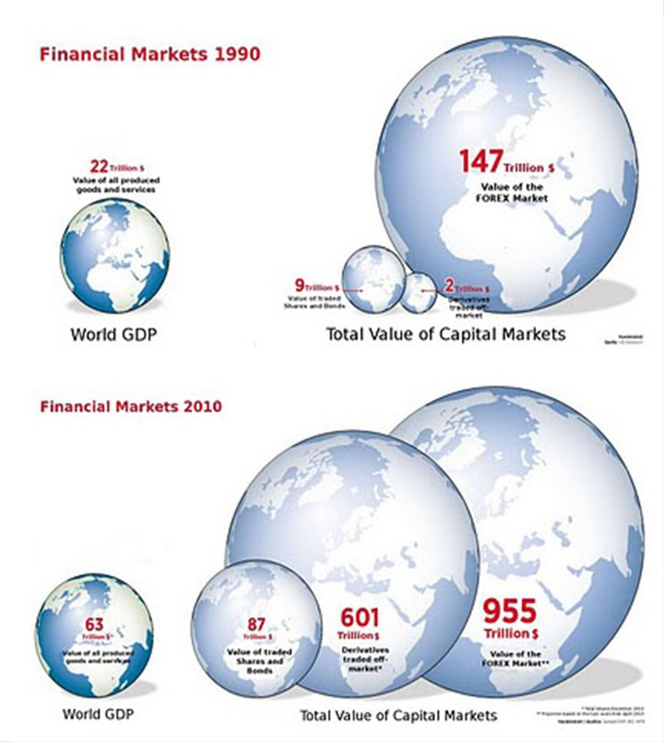
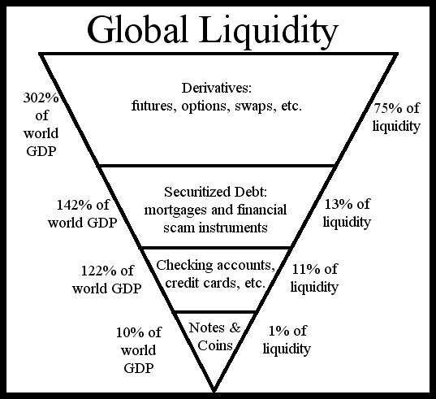

Slide 12
Central Bank
Financial
Sector
Credit
Expansion
Assets
Bubble
Liquidity
Unsustainable
Credit Expansion
Ponzi Scheme
Credit
Expansion
Physical
Economy
Value
Added
Finance
Relatively
Sustainable
Credit Expansion
Collateral

Slide 13
Global
Liquidity
Circuit
US Fed
liquidity
TNC investments
Derivatives
Market
infusion
Financial Sector
Physical
Economy
TNCs Profits
US Bonds
Credit
Expansion
Dollarization
Assets
Bubble
Economy
Assets Market
consumption

Slide 14
Trade Deficits and Debt as Tribute or Seignorage
1996-2010 Current Account Deficits: $ 6.98 Trillion, 60% of global deficits
2001-2007 $3.86 Trillion
B. Meanwhile US Net Foreign Debt increases by $2.3 Trillion
C. Profits: $4.67 Trillion
D. $2.3 Trillion Foreign Debt?

Slide 15
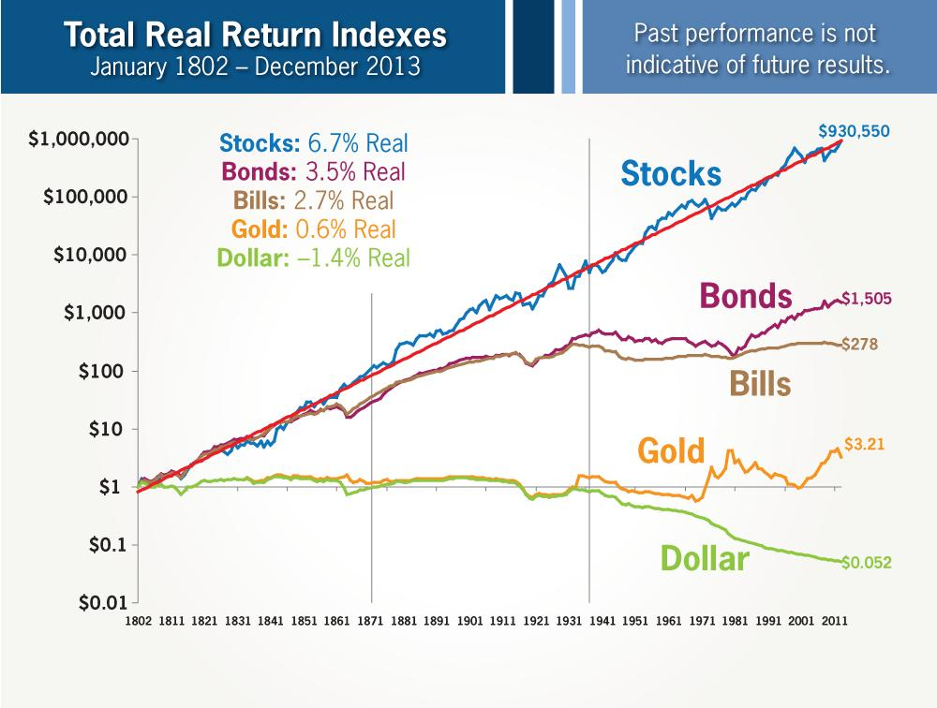

Slide 16
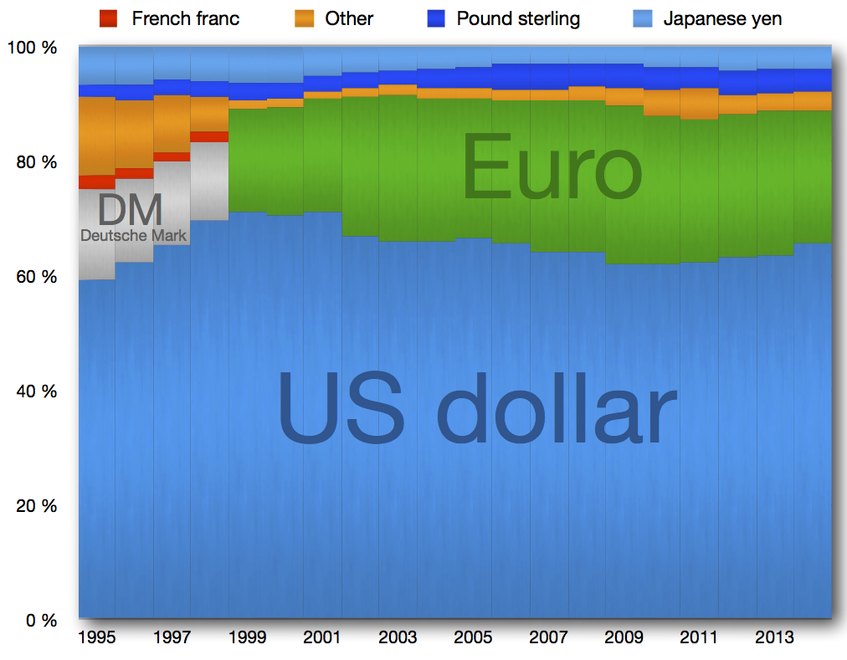
Global Reserve Currencies

Slide 17
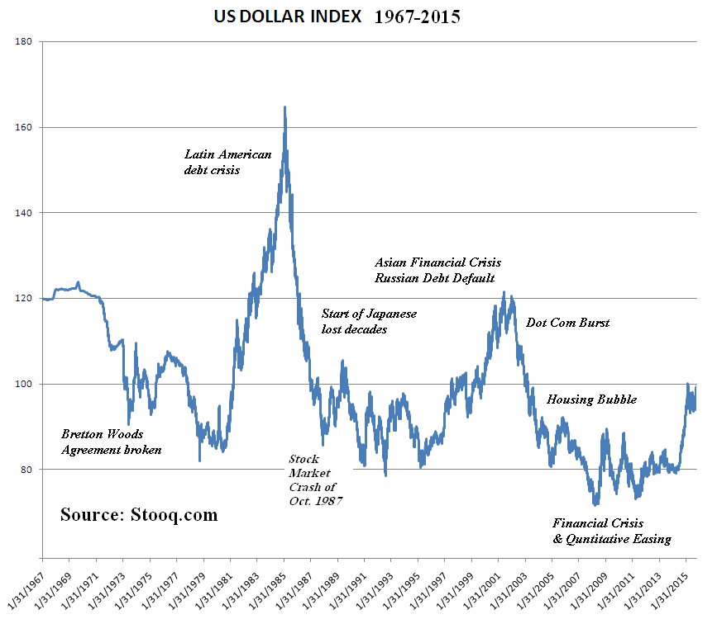
Dollar Cycle
Approximately 10 years going weak, 6 years going strong

Slide 18
Sheepshearing
1. US Fed Monetary Easing: liquidity into market
2. Emerging Markets Booming→ Assets Bubble
3. US Fed ends monetary easing. Tightening: rate cycle going up.
4. Capital flowing out of emerging markets. Financial & currency crises.

Slide 19
Sheeps Sheared
1. 1970s Latin America Debt Crisis
2. 1985-1990s Plaza Accord, Japan Assets Bubble
3. 1990s Shock Therapy in Russia
4. 1997 Asian Financial Crisis
5. 2013 Emerging Markets Crisis

Slide 20
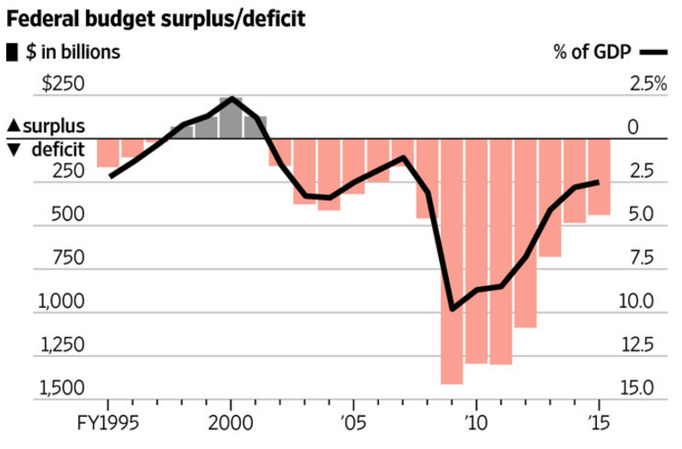
US: from fiscal expansion to strategic contraction

Slide 21
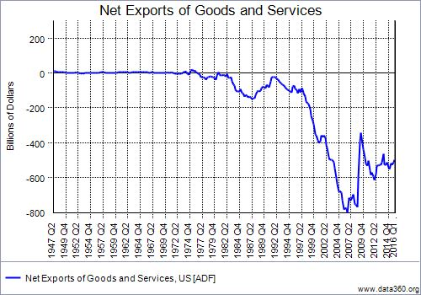
US Trade Deficits Contraction

Slide 22
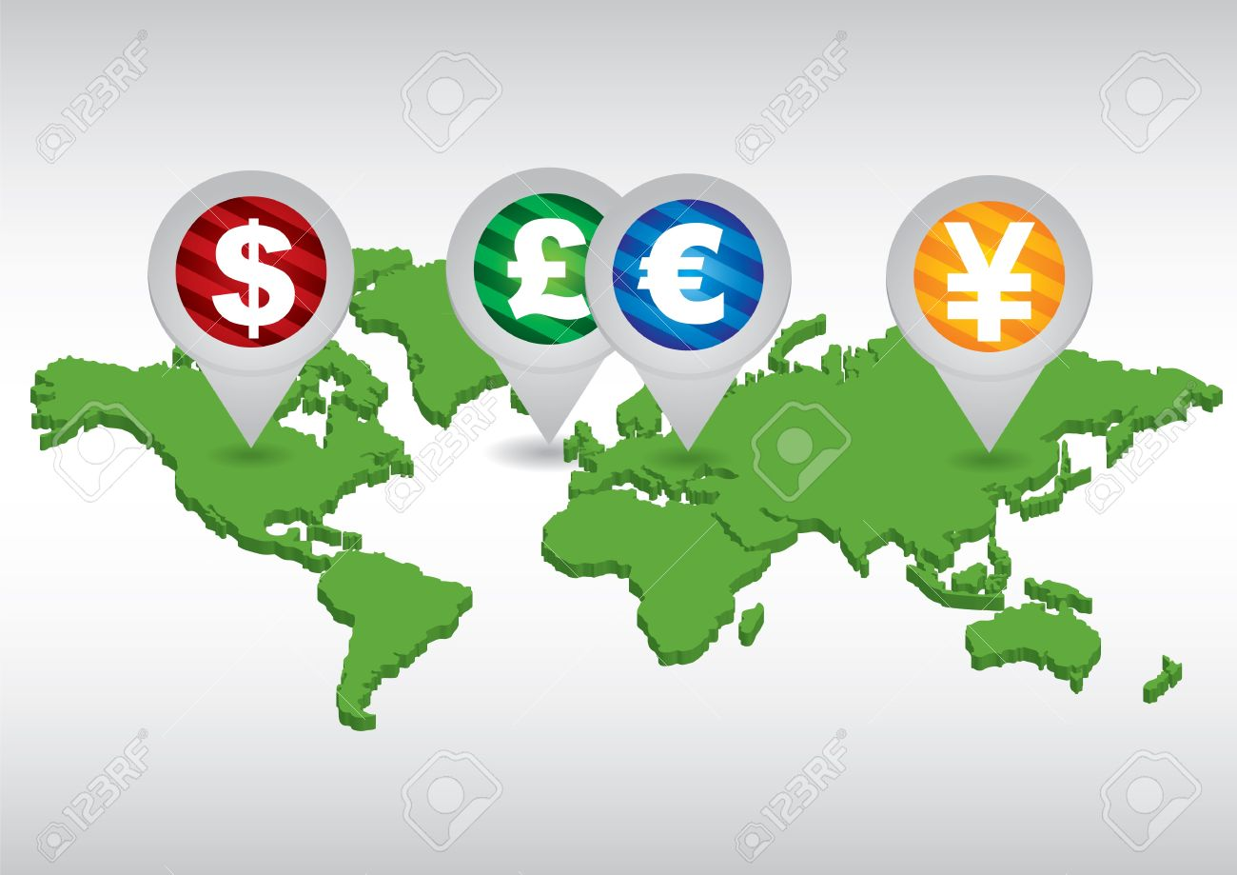
Clashes of Currency Hegemony
US Dollar
Euro:
Asian Currency/RMB

Slide 23
Reshaping of Geo-monetary Politics
Euro Zone:
Kosovo War, Ukraine Crisis, Middle East (scorched-earth tactic, ISIS), Refugee Crisis, Right-wing populism, Fascism, EU Disintegration
Asian Currency Alliance
Chiang Mai Initiative (2000)
China-Japan-Korea currency swap
“Re-balancing”

Slide 24
New Debt Regime
Washington Consensus turned up-side down
Creditor/Debtor, Double Standard
Astronomical Expansion of Debt
Global Tributary System

Slide 25
China, Turkey:
Empire→ State-Capitalism (modernization) → Neo-liberalism
Former Colonies, Resources Curse:
Brazil, South Africa, Venezuela
Rich in Resources, Incomplete Industrialization, Reprimarization: extraction, cash crop, cash husbandry
Sovereignty Externality
India, Indonesia
Rich in Labor Force
Strong Informal Sector
Deep-grained regional conflicts

Slide 26
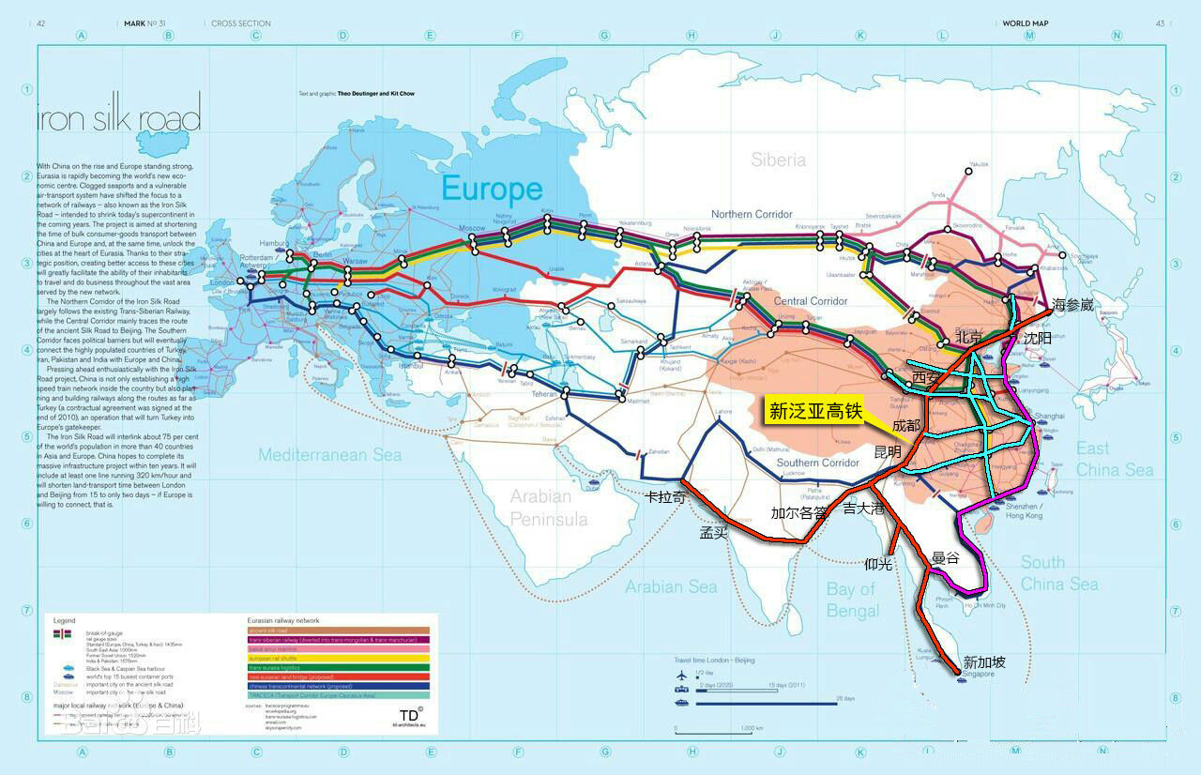
Silk Road Belt

Slide 27
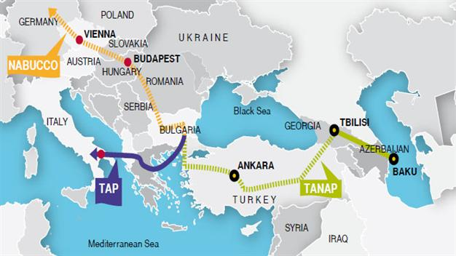
The Southern Gas Corridor
Trans Adriatic Pipeline TAP
Trans Anatolian Pipeline TANAP
South Caucasus Pipeline

Slide 28
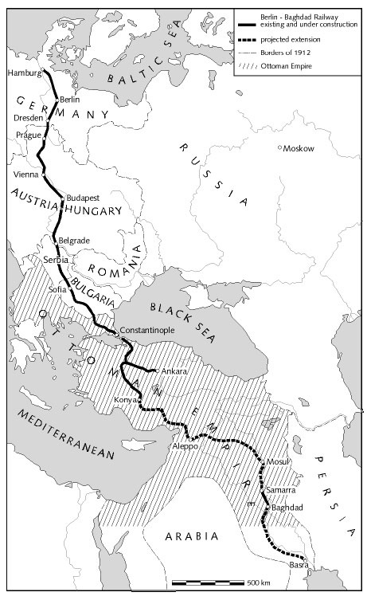
Berlin – Baghdad
Railway
: flash point of WWI

