Slide 1
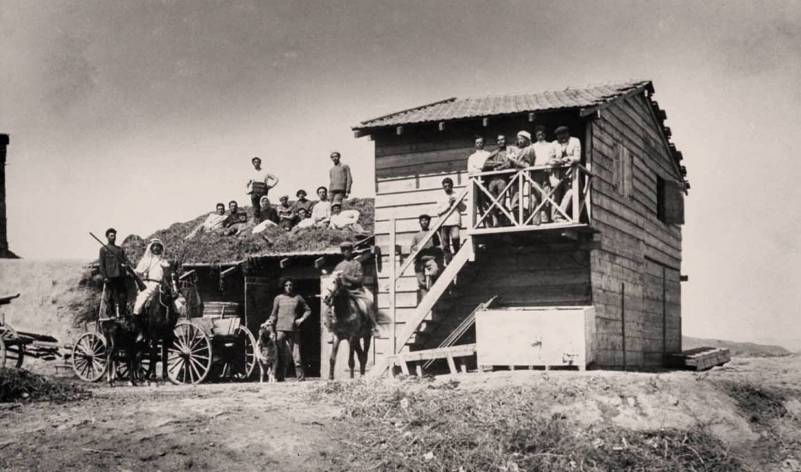
DEGANIA - THE FIRST KIBBUTZ
Was created in 1909. 300 members

Slide 2
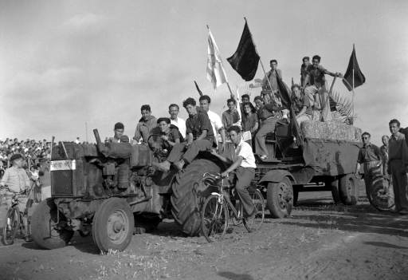
First tractor

Slide 3
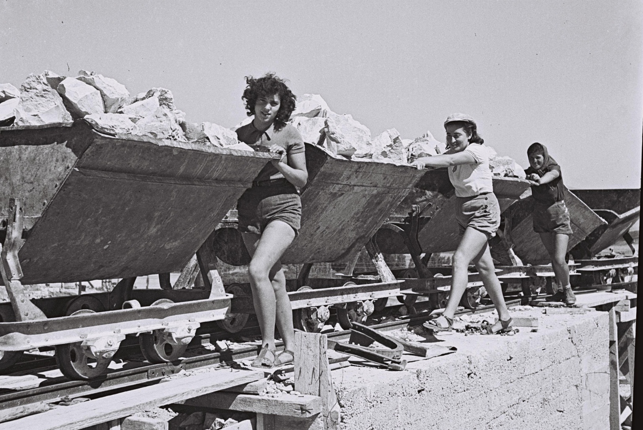

Slide 4
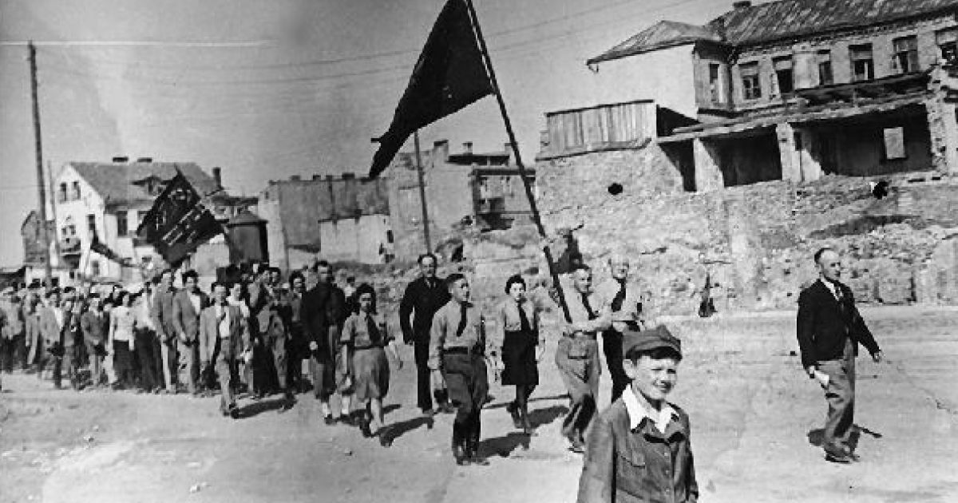
Demonstration on the 1st of May

Slide 5
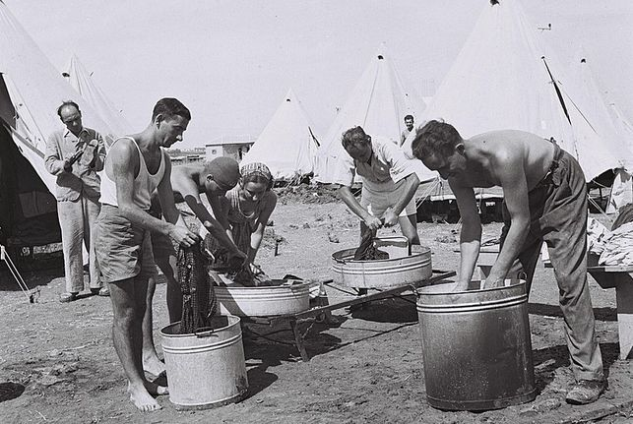

Slide 6
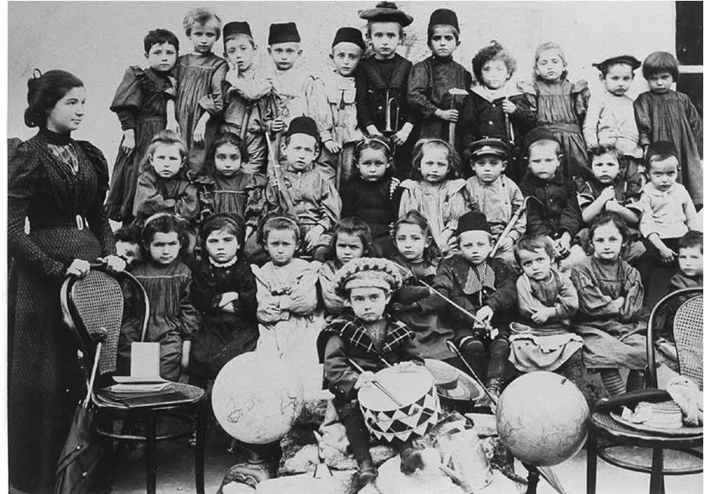
Kinder garden

Slide 7
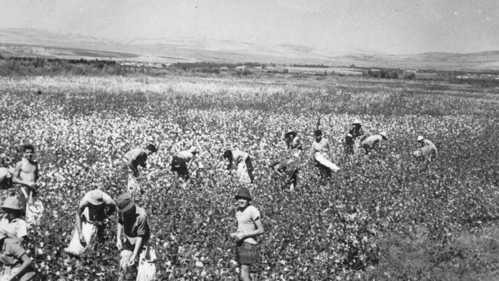

Slide 8
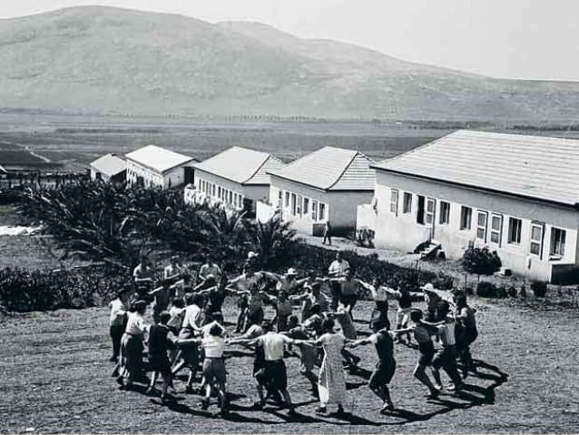
Immediately following the declaration of the new state, both superpower leaders, US President Harry Truman and Soviet leader Joseph Stalin , recognized the new state.

Slide 9
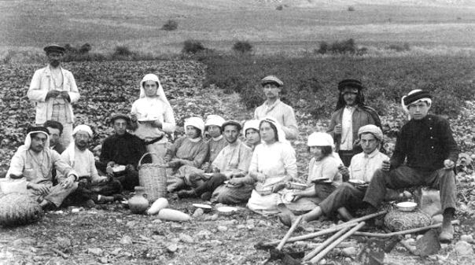

Slide 10
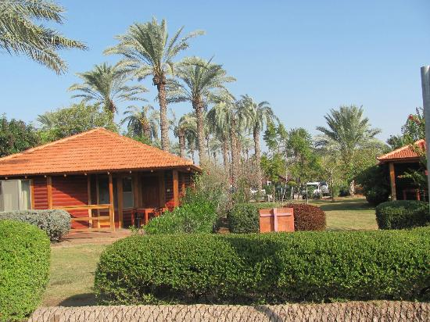
Modern Kibbutz

Slide 11
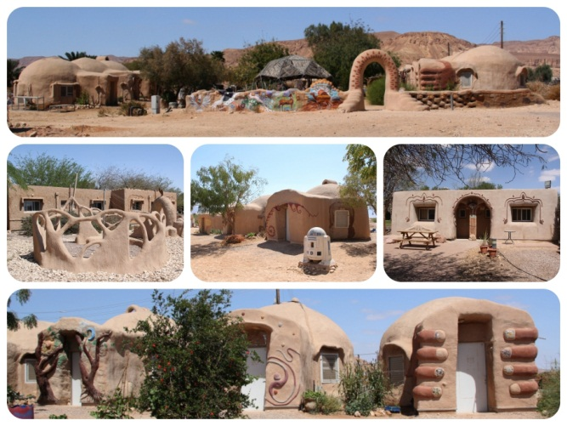
Ecological Kibbutz

Slide 12
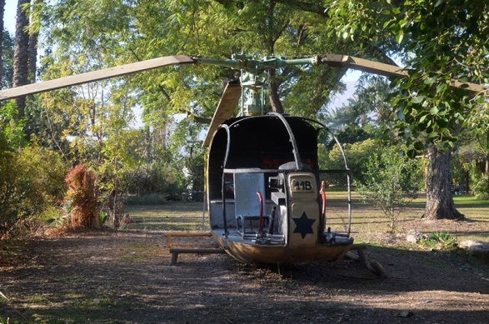
Helicopter

Slide 13
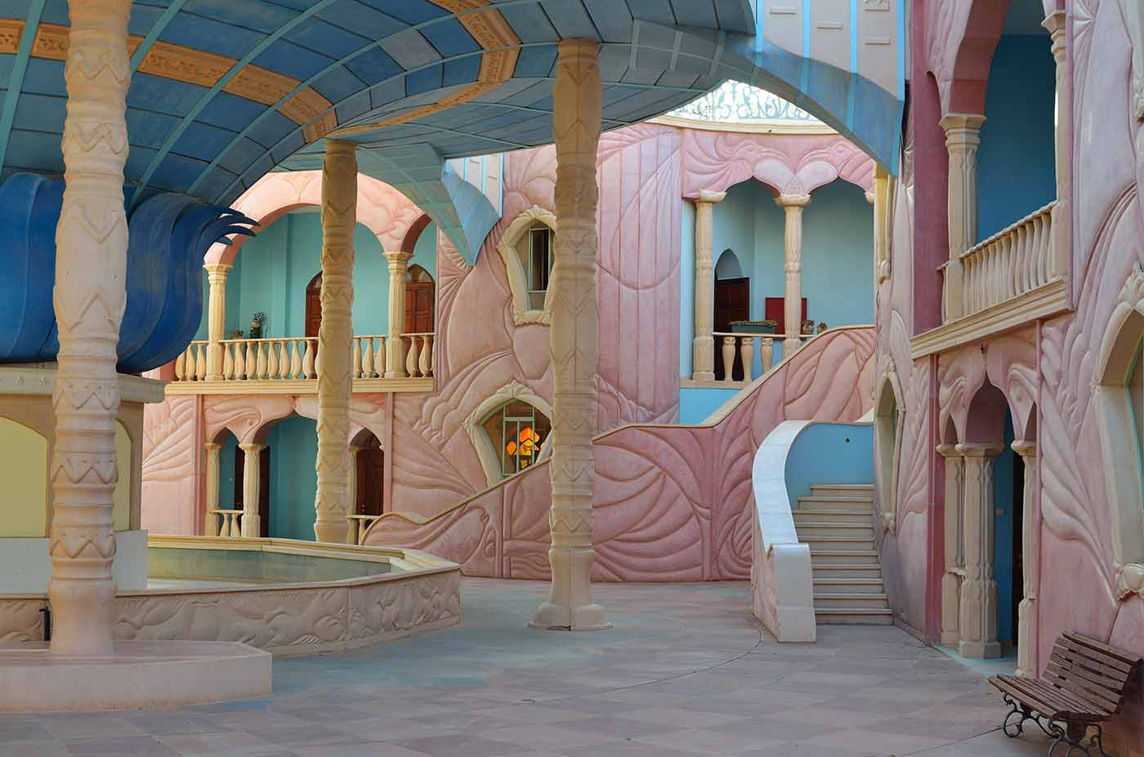
Kibbutz in Eylat

Slide 14


Slide 15
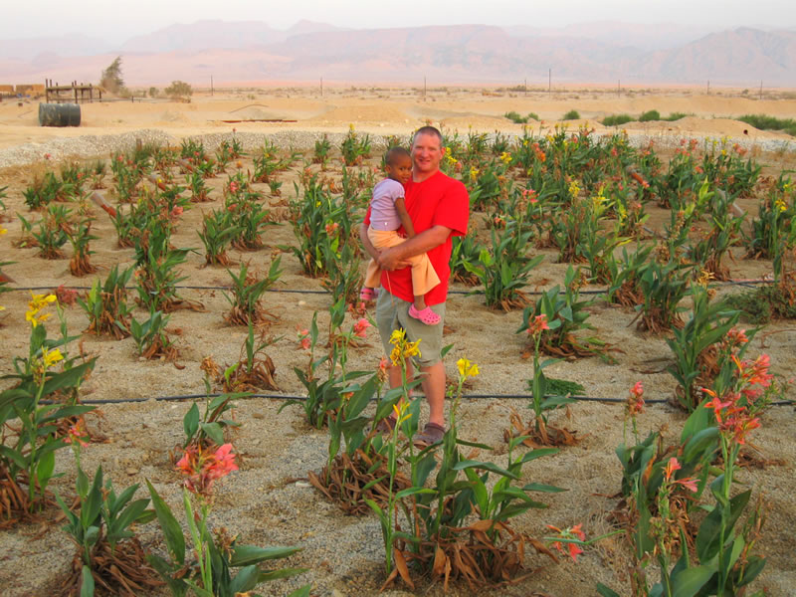
Kibbutz in desert

